Slide 1

Session 01
Introduction to Windows Forms

Slide 2
Objectives
Windows Forms
Form class
Types of Controls
Basic controls

Slide 3
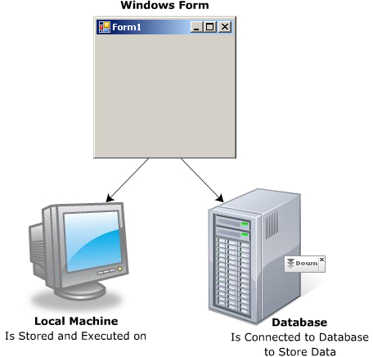
Need for Windows Forms
Windows Forms allows the developer to create UI using various built-in components. These components are controls that allow you to take information and view the requested information through the form. This makes the application user-friendly.
The role of Windows Forms include
Holding controls
Handling user input
Display information
Connecting to database, which might exists on another machine

Slide 4
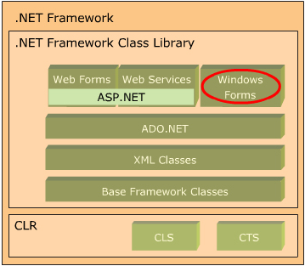
Windows Forms in .NET Framework
WF are a part of the .NET framework that a multi-lingual and multi-platform environment to build, deploy, and run application

Slide 5
Features of Windows Forms
ClickOnce Deployment
Application Settings
New Windows Forms Controls
New Data Binding Model
Rich Graphics

Slide 6
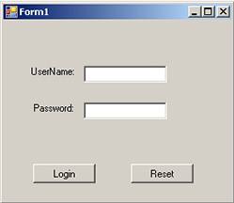
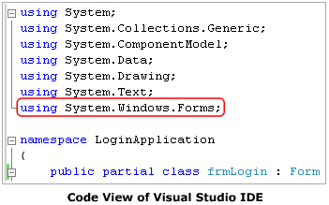
“Form” class
The basic unit of an application is a form. A form is a container that hold and manages controls and is used to create GUI based Windows application.

Slide 7
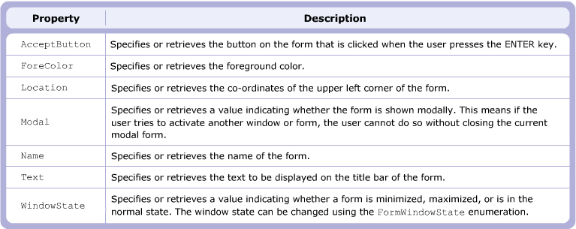
Properties

Slide 8
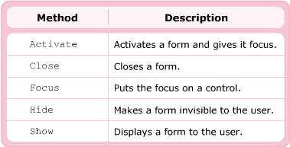
Methods

Slide 9
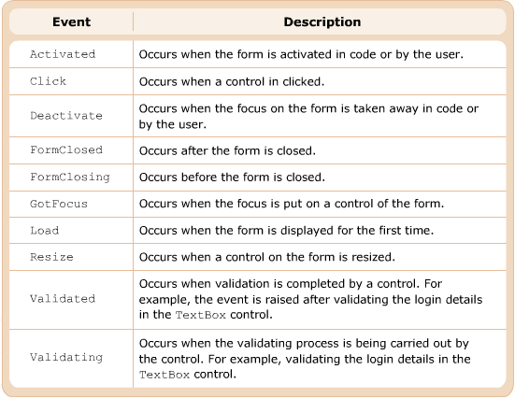
Events
The events of the form class allow the form to respond to the actions performed by the user on the form.

Slide 10
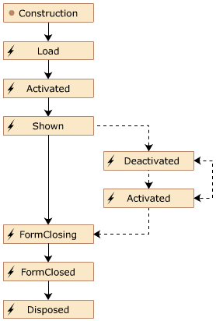
Lifecycle of Window Forms
The life of a WF starts when you create the object of the Form class.

Slide 11
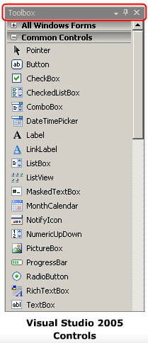
Types of Controls>> Use of Controls
A control is a visual object that is added on a form to create graphical user interfaces for an application. The purpose of a control is to display information or to take the information from the user.

Slide 12
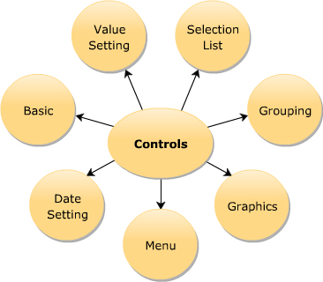
Types
All the controls available for WF programming are inheritance from Control class. This class is used to customize the appearance of the controls and handle the user input received through controls. The class is defined in System.Windows.Forms namespace.

Slide 13
“Control” class
The Control class is the base class of all the controls available for WF programming. This class is defined in System.Windows.Forms namespace and defines various properties, method, and events.
The properties and method of a form can be read or set using the this keyword.
[ControlName].[PropertyName]
Or
this.[ControlName].[PropertyName]

Slide 14
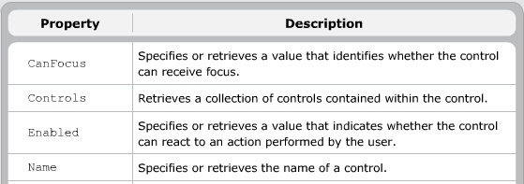
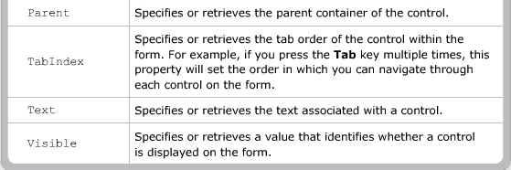
Properties

Slide 15
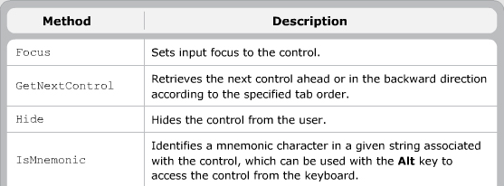

Methods

Slide 16
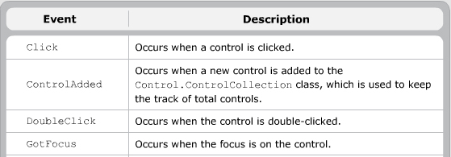
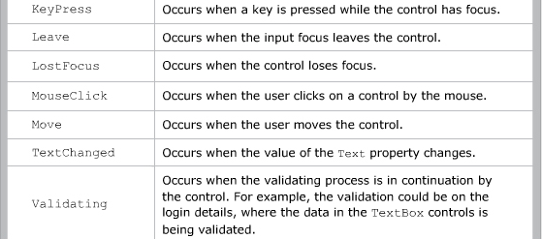

Events

Slide 17
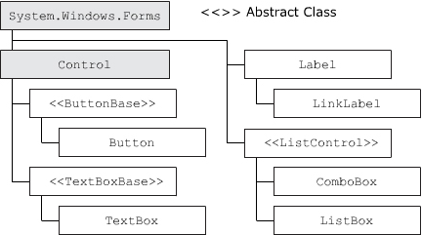
Common controls
A form contains controls such as TextBox, Label, Button, and so on. All these controls are associated with a built-in class defined in the .NET class library

Slide 18
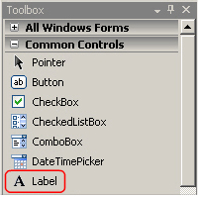
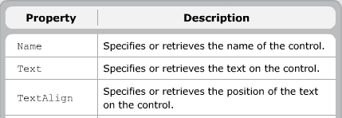
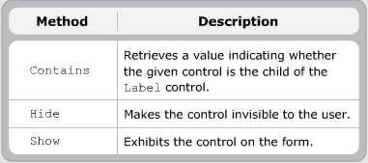
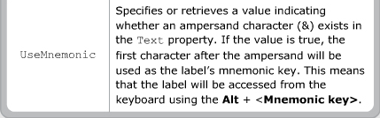

Label control
The Label control is a control that is used to show detailed information. The most common purpose of the Label control is to provide captions to the controls

Slide 19
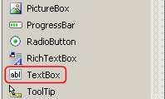
“TextBox” control
The TextBox control takes the required information from the user, which can be modified

Slide 20
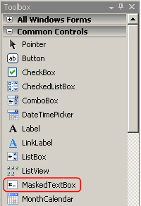
“MaskedTextBox” control
The MaskedTextBox control is a new control used to validate user input. It is an extension of the TextBox control and can perform validations for checking.
Total input characters
Numeric and alphabetical characters
Casting
Special characters such as ‘/’ and ‘-’

Slide 21
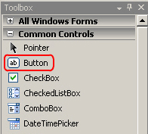
“Button” control
The Button control provides the easiest way to allow the user to interact with an application. The user can click the button to perform the required action.

Slide 22


“ListBox” control
The ListBox control is a control used to select a single value or multiple values from the given list of values.

Slide 23
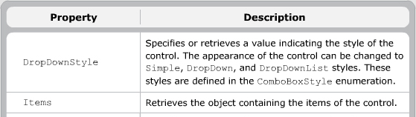
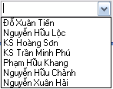
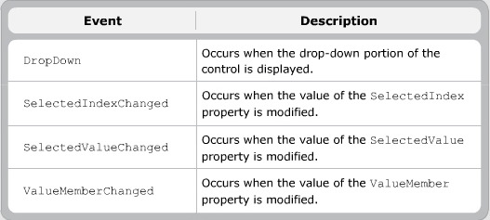
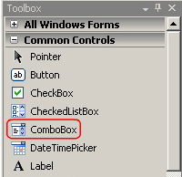
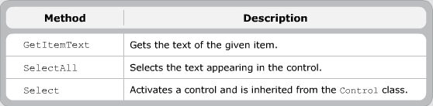
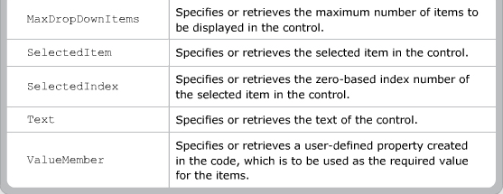
“ComboBox” control
The ComboBox control is similar to the ListBox control, but it allows you to select only one value at a time. In addition, you can type the value even if the value is not present in the list.

Slide 24
Summary and Workshop
Windows Forms
Form class
Types of Controls
Basic controls

Slide 25

THANKS FOR WATCHING !

